Slide 1

Power point karaoké
Agicap unconf (October 13th, 2022) Thomas Pierrain (@tpierrain), inspired by huijing.github.io

Slide 2
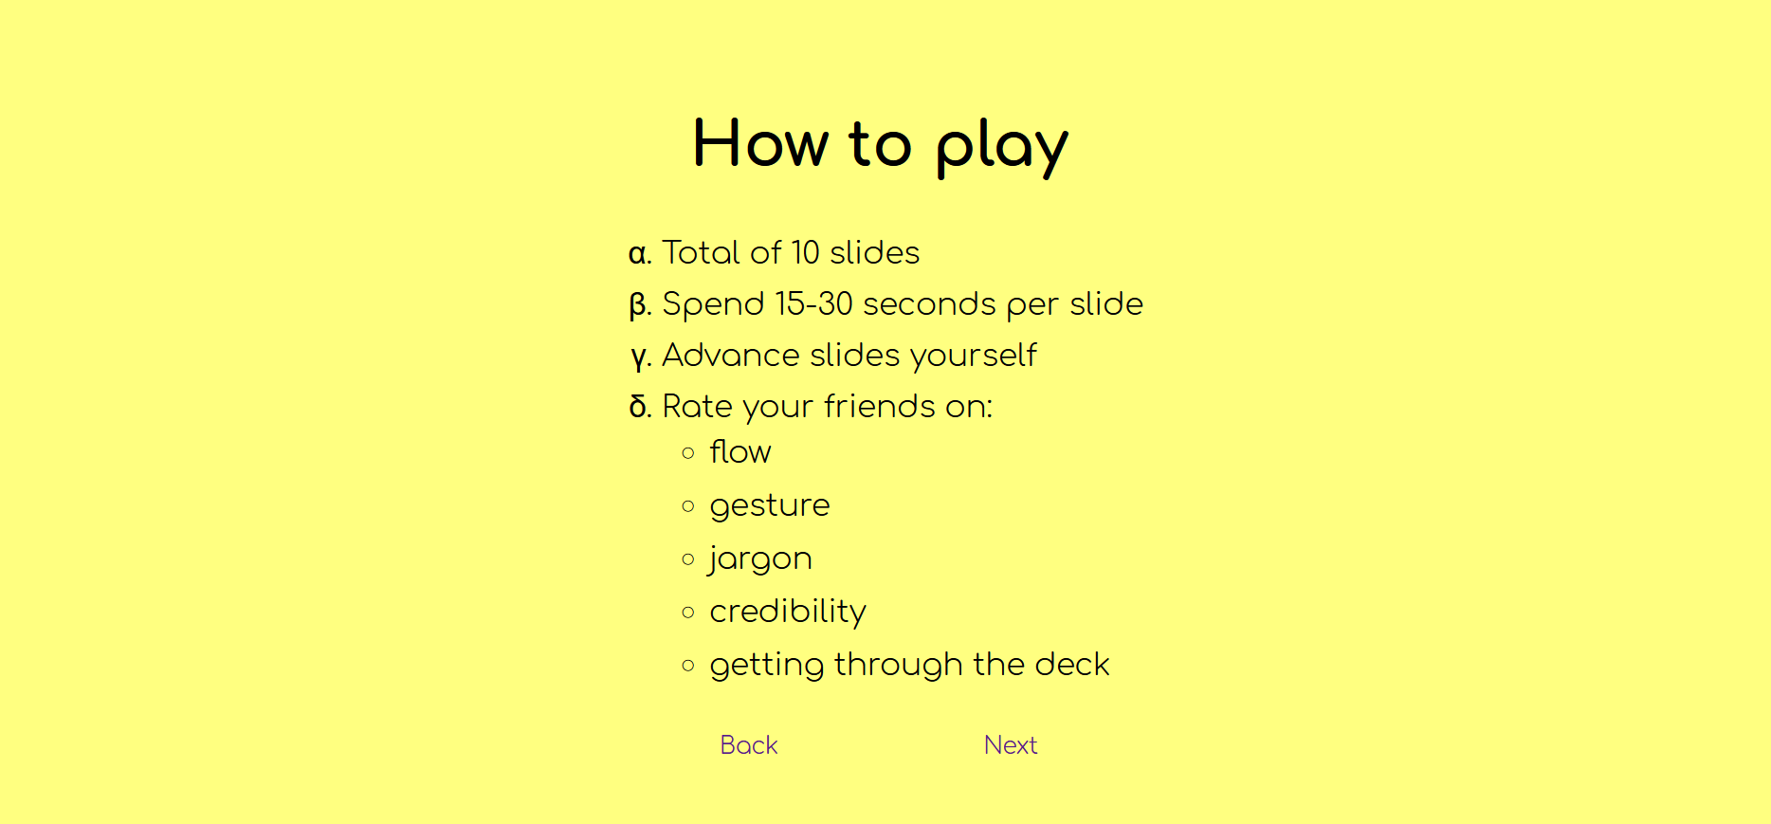
How to play
Spend 15-30 seconds per slide
Advance slides yourself
Rate your friends on:
Flow
Gesture
Jargon
Credibility
Getting through the deck

Slide 3
Situational intelligence

Slide 4
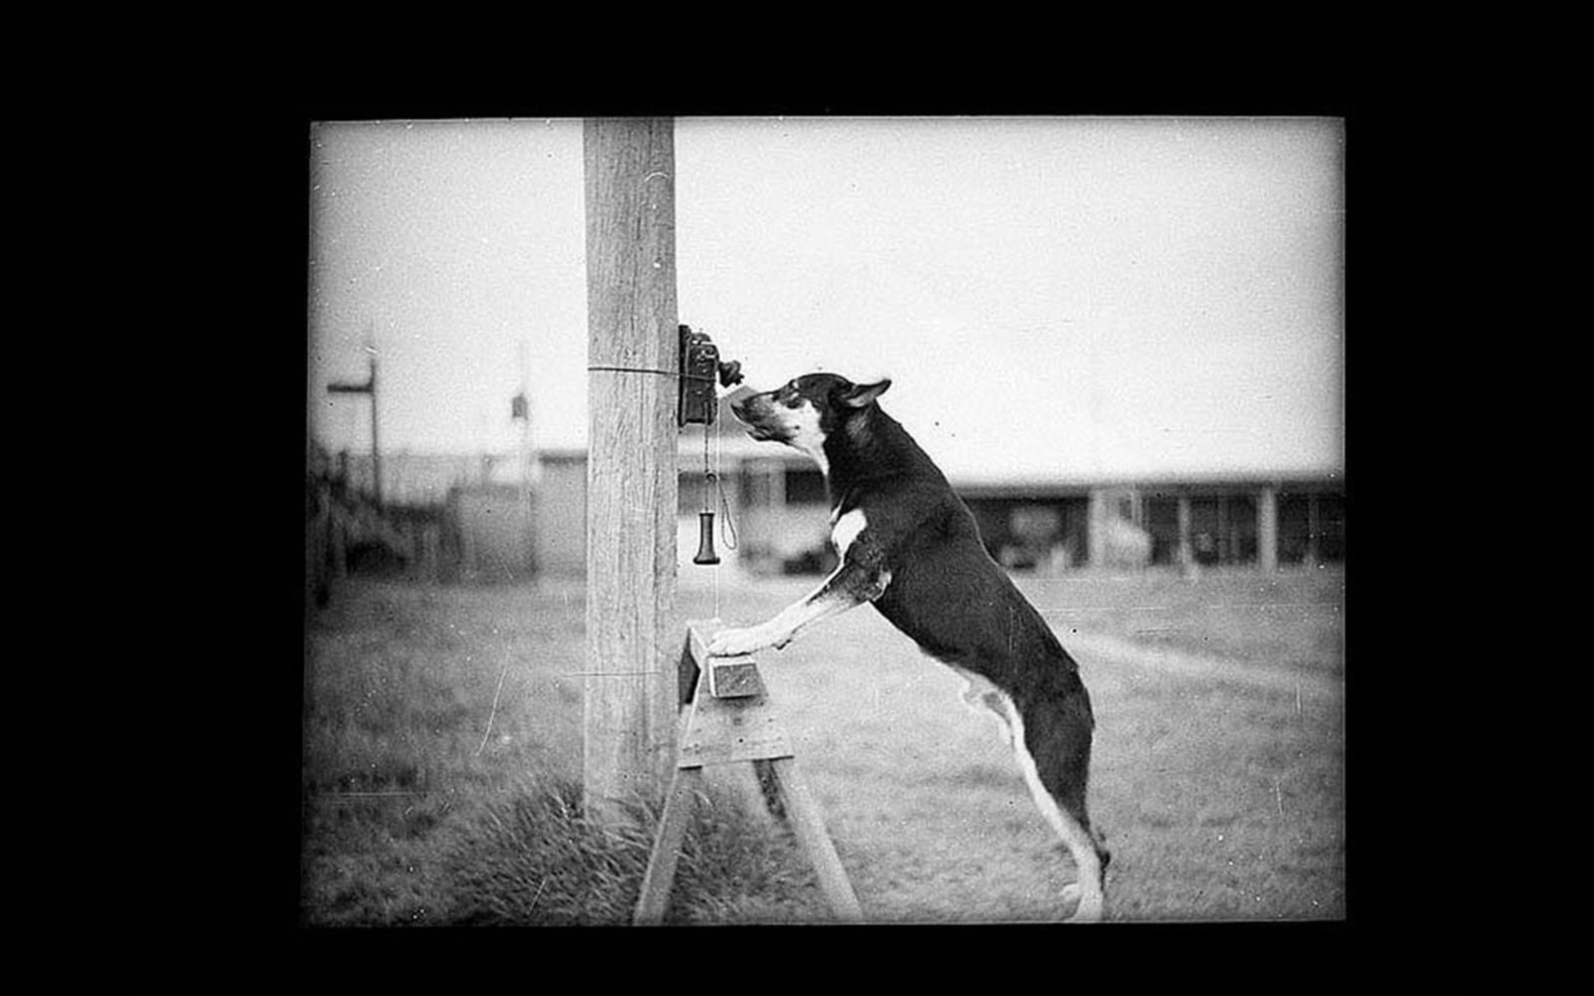

Slide 5
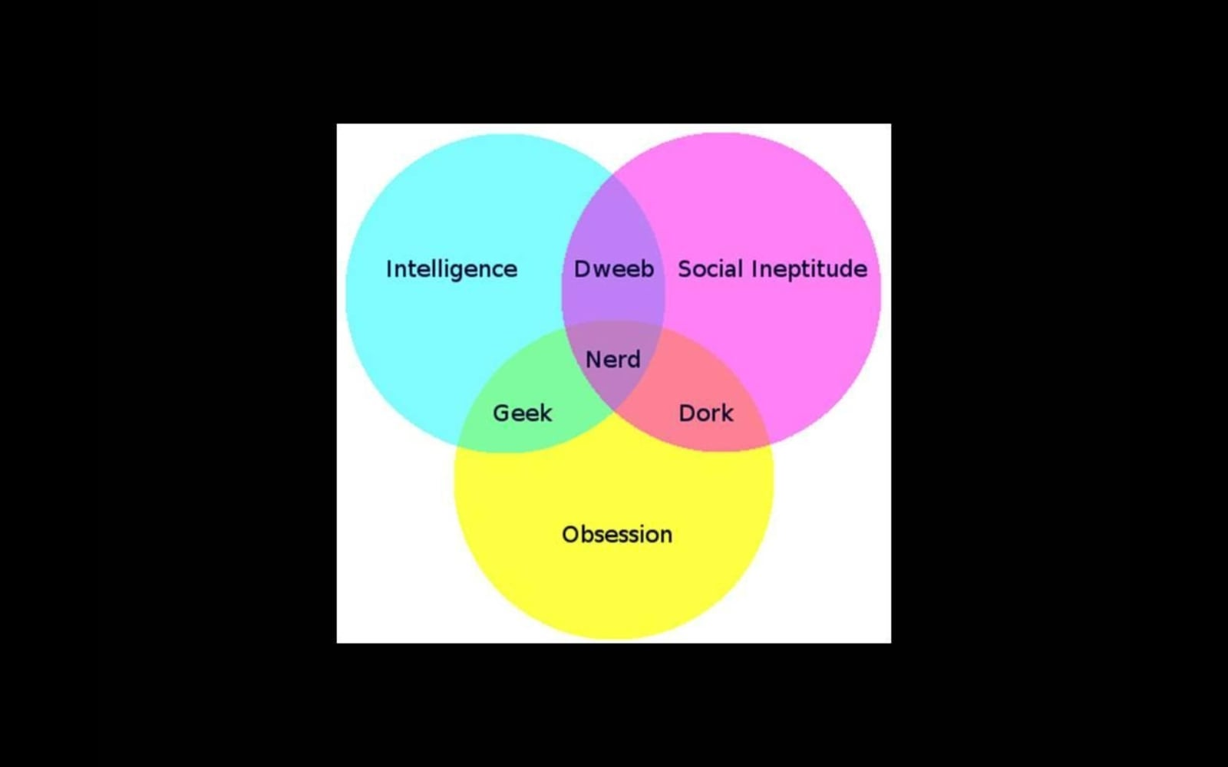

Slide 6
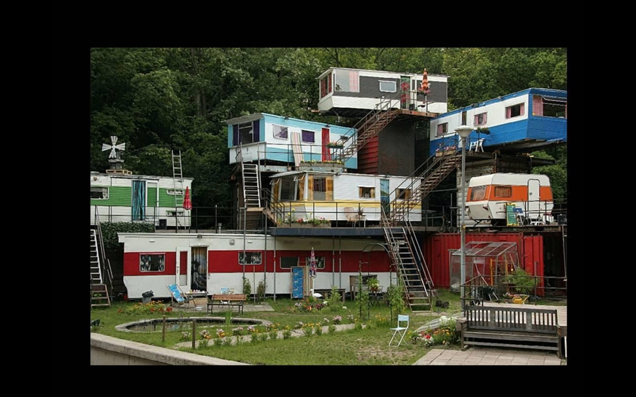

Slide 7
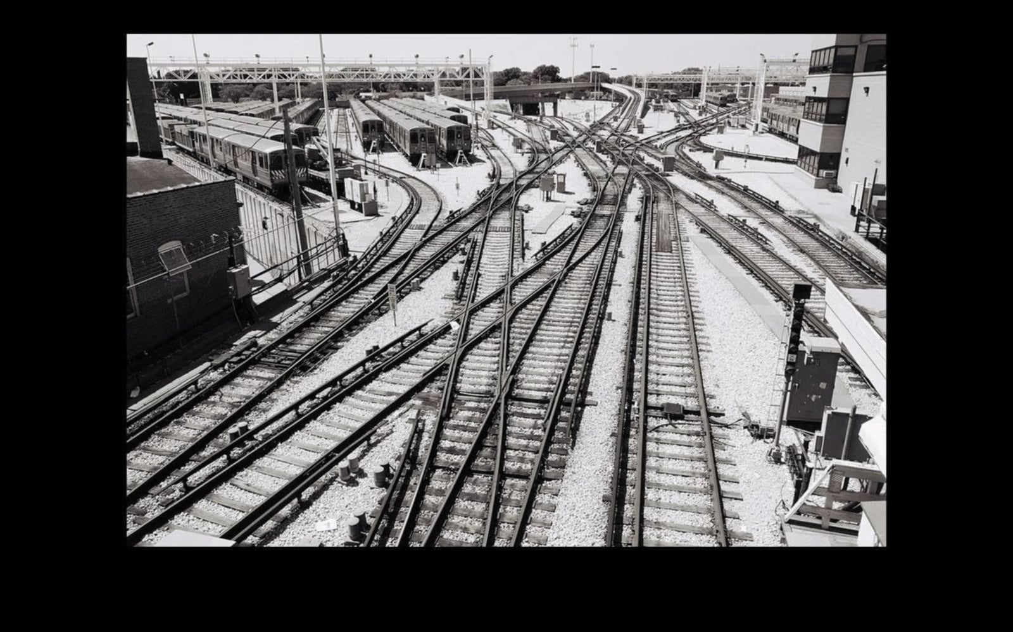

Slide 8
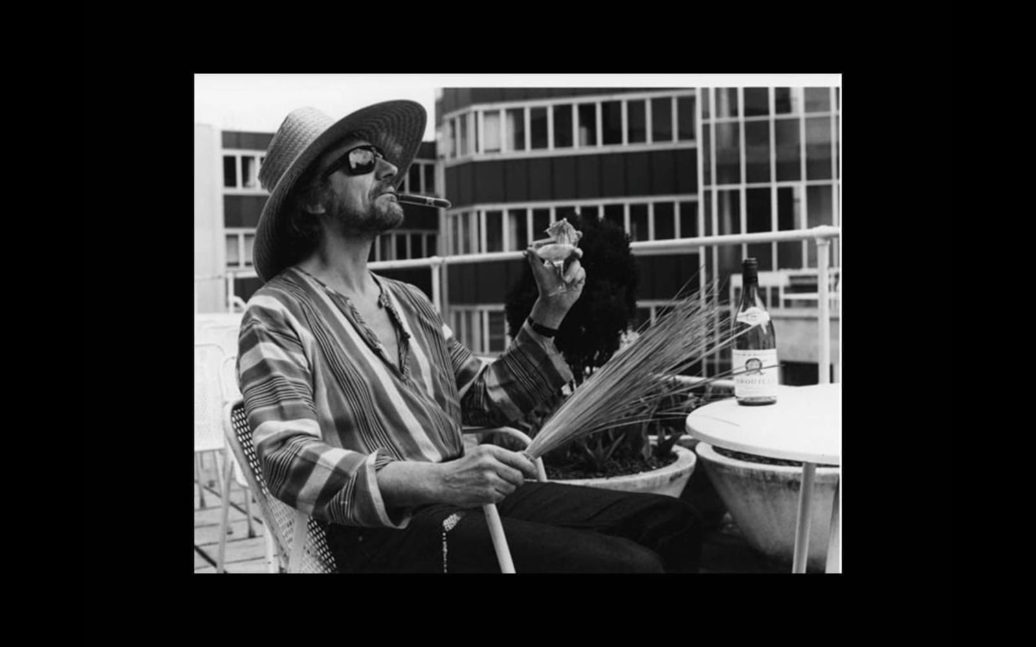

Slide 9
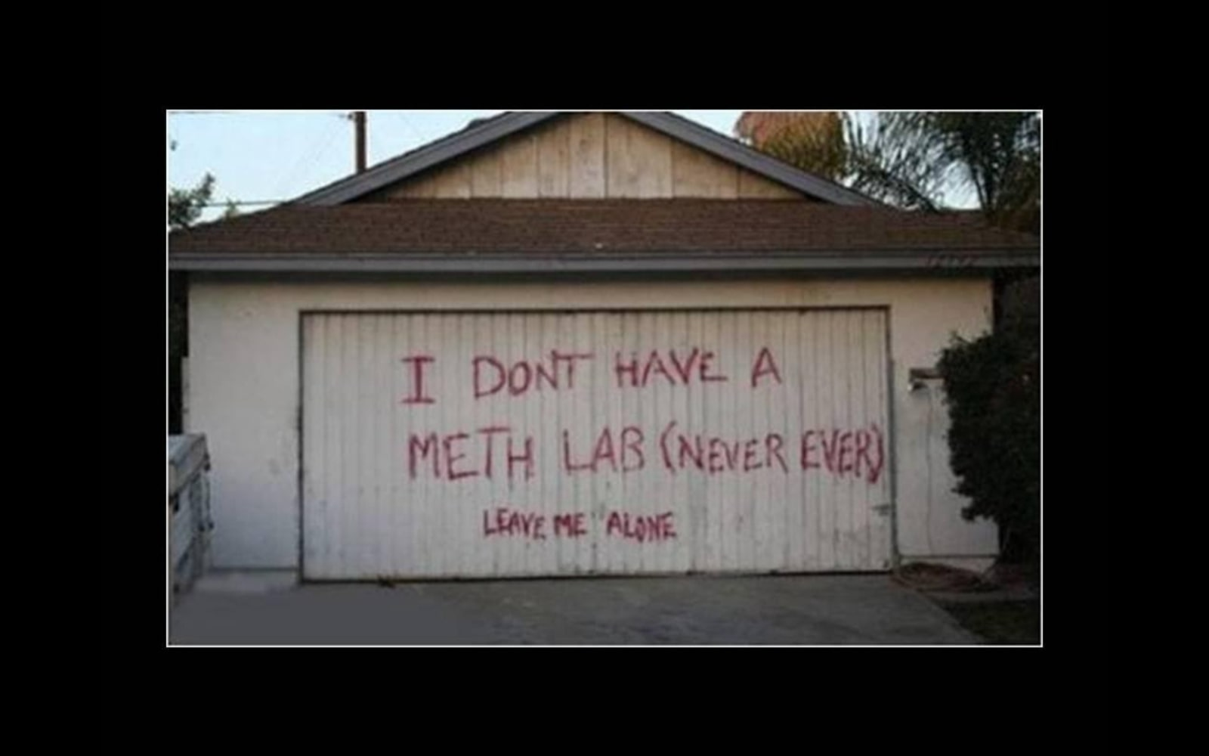

Slide 10
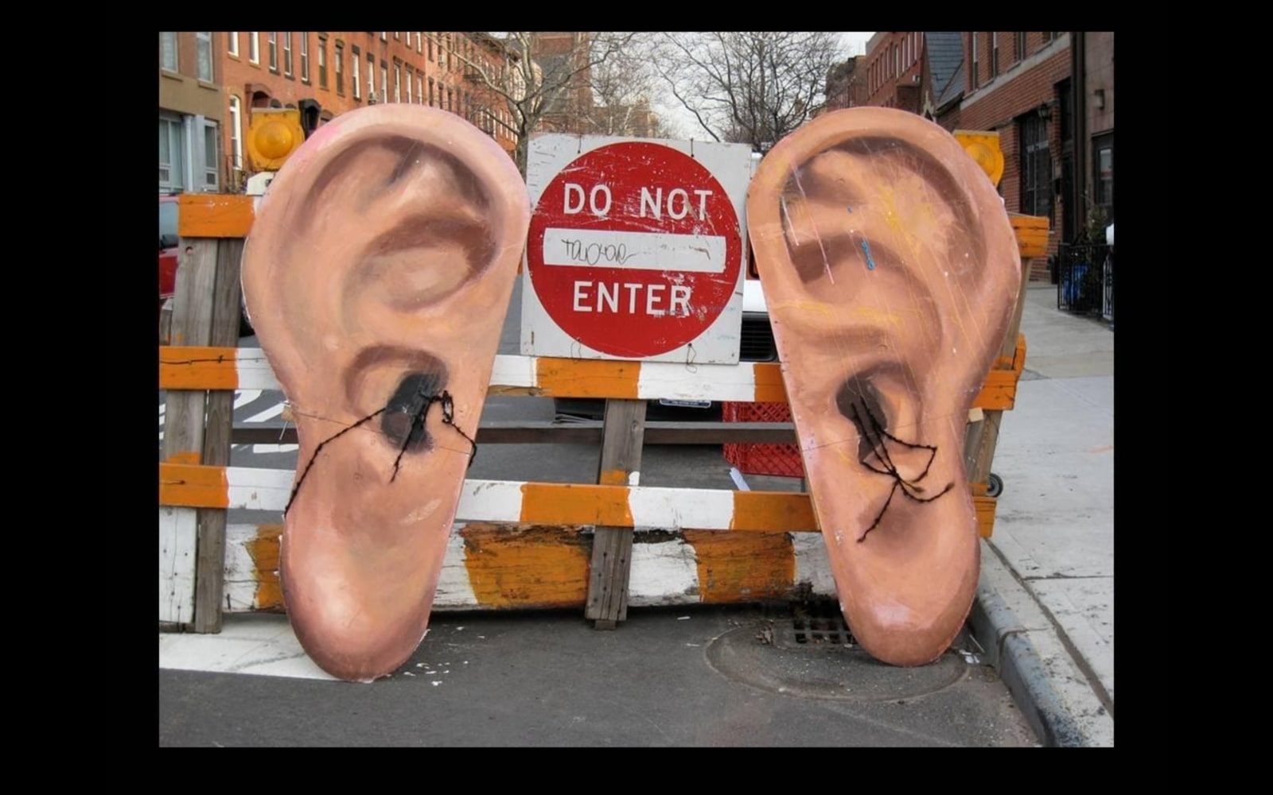

Slide 11
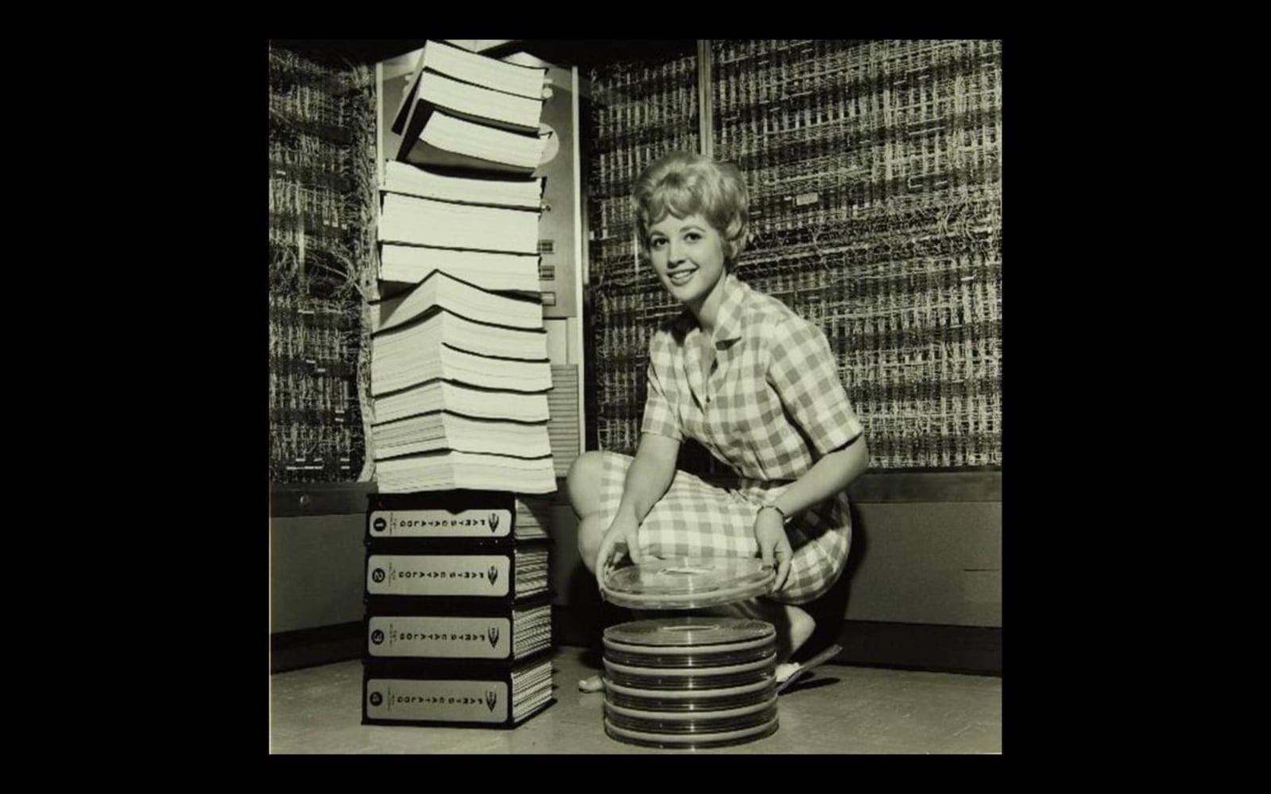

Slide 12
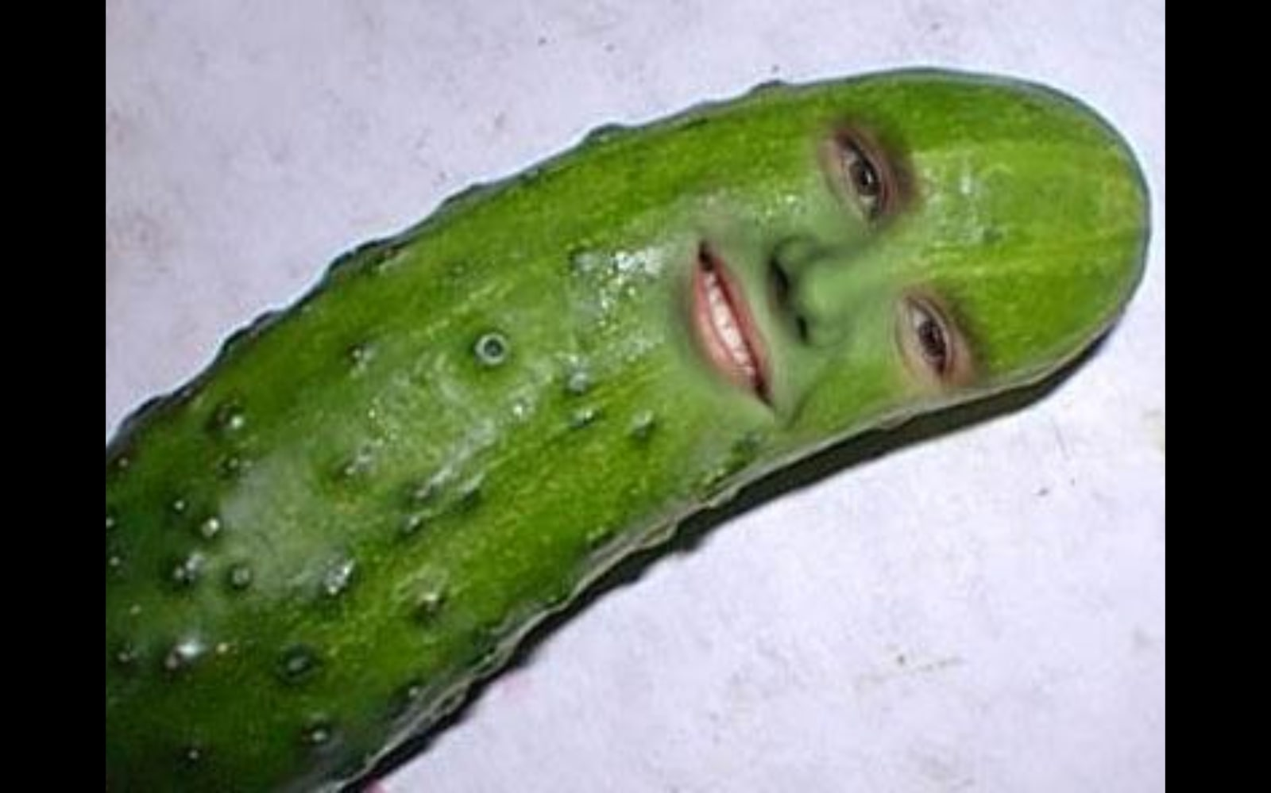

Slide 13
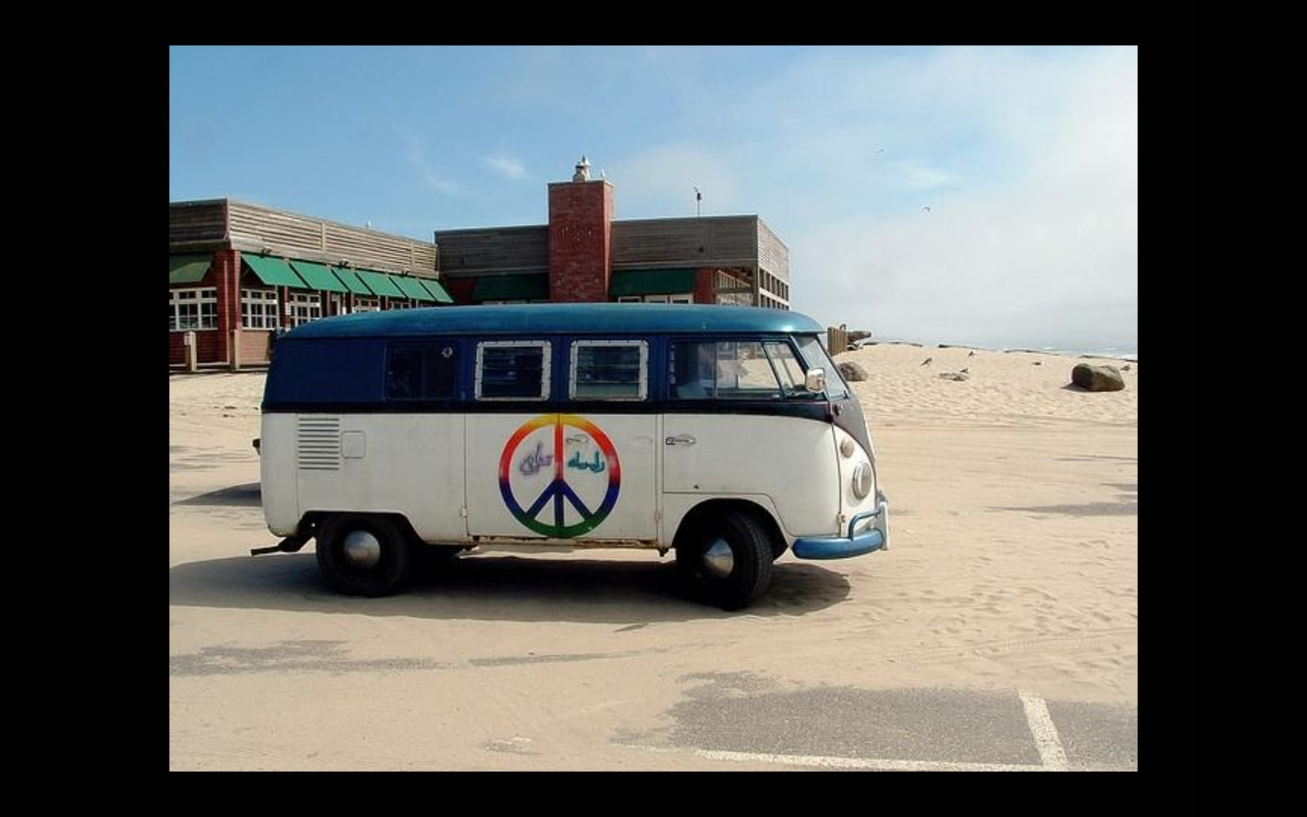

Slide 14
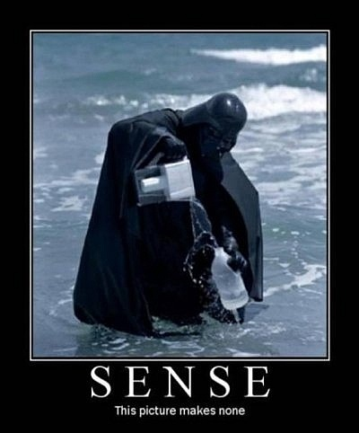

Slide 15
And you’re done!
Please give a round of applause

